Slide 1
District 2E2
Eyeglass
Recycling
Center
5321 Bunker Blvd.
Watauga, TX 76148

Slide 2
According to the World Health Organization, 153 million people have uncorrected refractive errors (near-sightedness, far-sightedness, astigmatism). Most of these vision impairments are quickly diagnosed and easy to treat with corrective lenses. It costs Lions less than $0.08 US to provide a pair of recycled eyeglasses and change someone's life. For children, clear vision means a better education, healthier development and a better quality of life. For adults, it means greater employment opportunity and economic strength. For seniors it means less dependence on others.
The need for glasses –
153 million reasons Lions Recycle for Sight

Slide 3
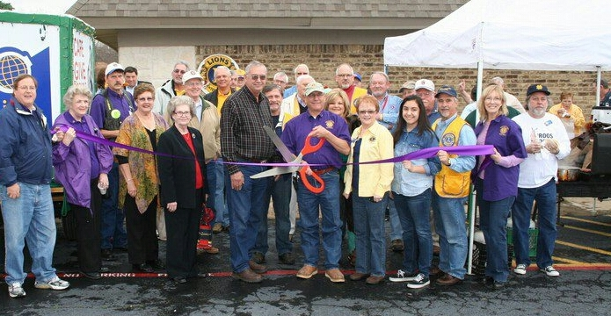
District 2E2 Eyeglass Recycling Center
Grand Opening
The grand opening for the District 2E2 Eyeglass Recycling Center was held in January of 2013. The District 2E2 Eyeglass Recycling Center was voted a district recognized entity at the 2014 district convention.

Slide 4
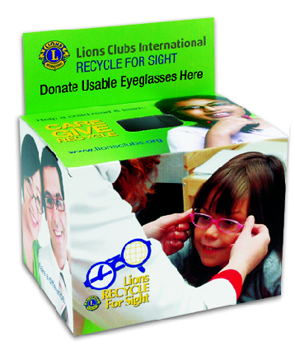
Put eyeglass collection boxes in schools, libraries, places of worship, city administrative centers, medical offices, and places of business. Eyeglass collection boxes are available from Lions Clubs International or the District 2E2 Eyeglass Recycling Center.
Start or Expand
Your Club’s Eyeglass
Collection Program

Slide 5
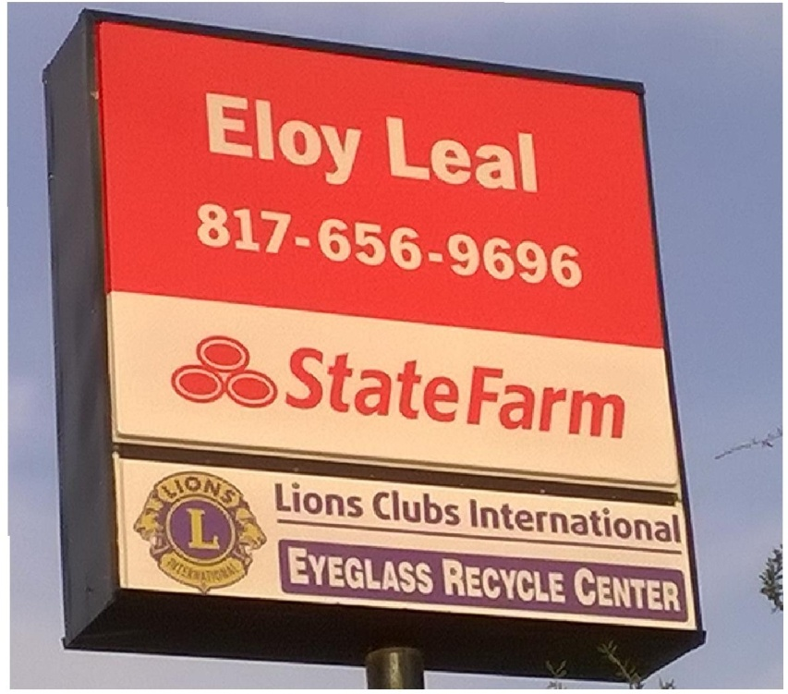
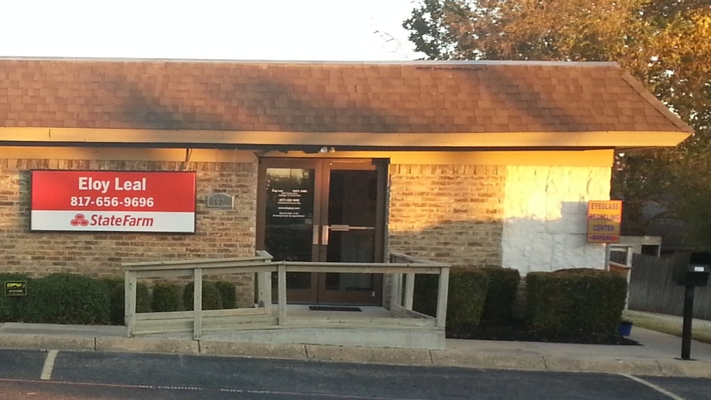
District 2E2 Eyeglass Recycling Center
5621 Bunker Blvd.
Watauga, TX 76148
The eyeglass recycling center is located in the rear of Lion Eloy Leal’s insurance
office. Just follow the walkway on the east side (right) of the building.
Bring your collected glasses to the Eyeglass Recycling Center, open every Saturday from 9:00am to 3:00pm. Please call any director to arrange a work session for your club at a different day or time.

Slide 6
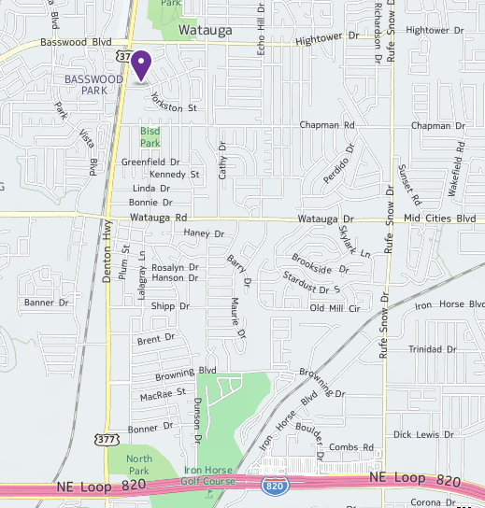
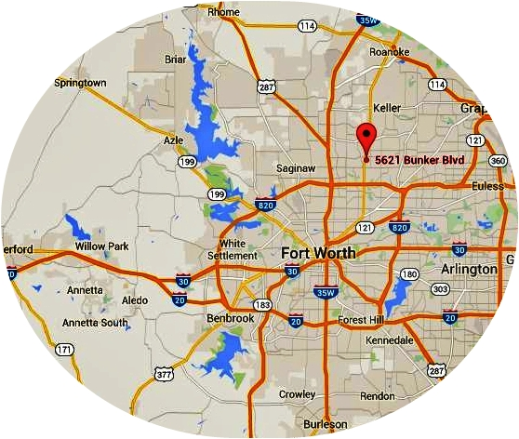
The District 2E2 Eyeglass Recycling Center is centrally located in the city of Watauga.
5621 Bunker Blvd.
Watauga, TX 76148

Slide 7
2014 — 2016 Lion Jim Cook 817.319.0799 Roanoke Lions Club 1VDG Tom Hayford 469.831.5403 Lewisville Lions Club Lion Roman Figueroa 817.507.9586 Colleyville Lions Club 2015 — 2017 Lion Bob Cole 817.371.8135 Roanoke Lions Club Lion Susan Cole 817.368.4976 Roanoke Lions Club Lion Dennis Stiles 817.773.2278 Colleyville Lions Club 2015 — 2018 Lion Jon Atwood 817.296.9921 Colleyville Lions Club PDG Jan Carrington 940.391.4142 Denton Lions Club Lion Kate Nelson 682.708.8916 FW Southeast Lions Club
District 2E2 Eyeglass Recycling Center
2015-2016 Board of Directors

Slide 8
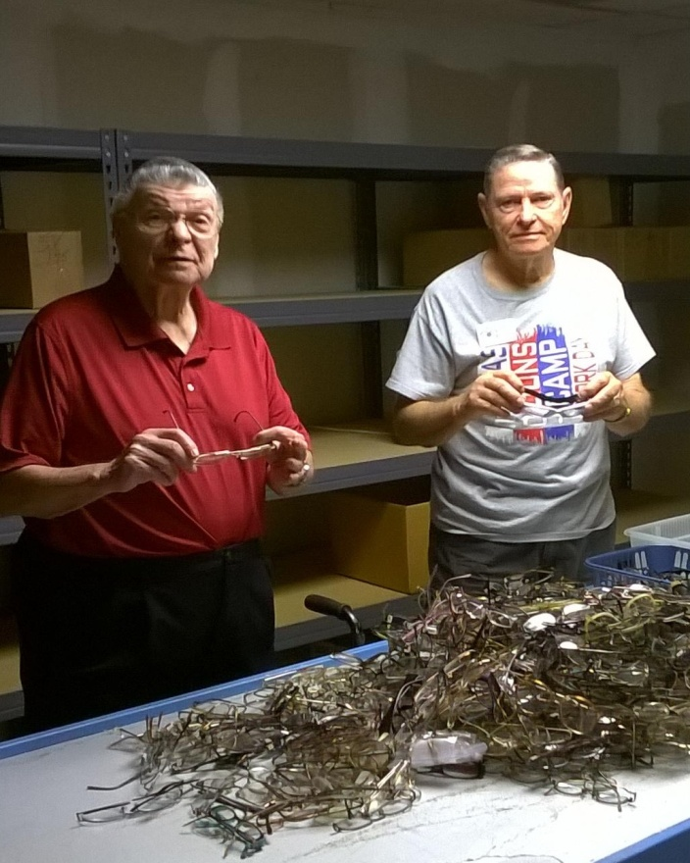
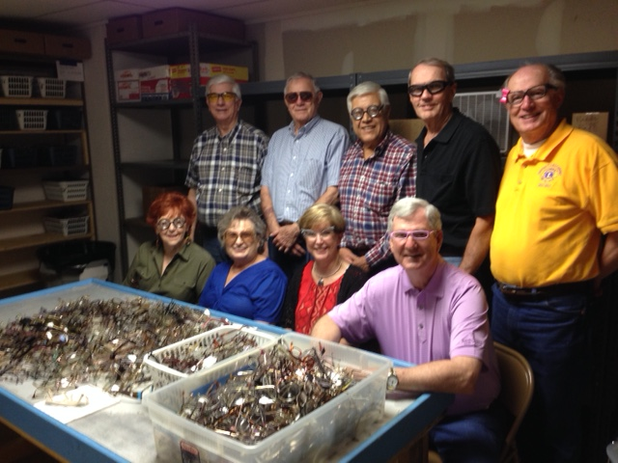
Glasses are sorted into 2 categories, glasses that will continue in our process (single vision prescription, reading glasses, and non-prescription sunglasses), and glasses that will be sent to a materials recycler (broken or scratched glasses, missing lenses and multi-focal). We cannot use any cases. Please remove glasses from the cases before bringing them.
Processing Glasses Step 1: Sorting

Slide 9
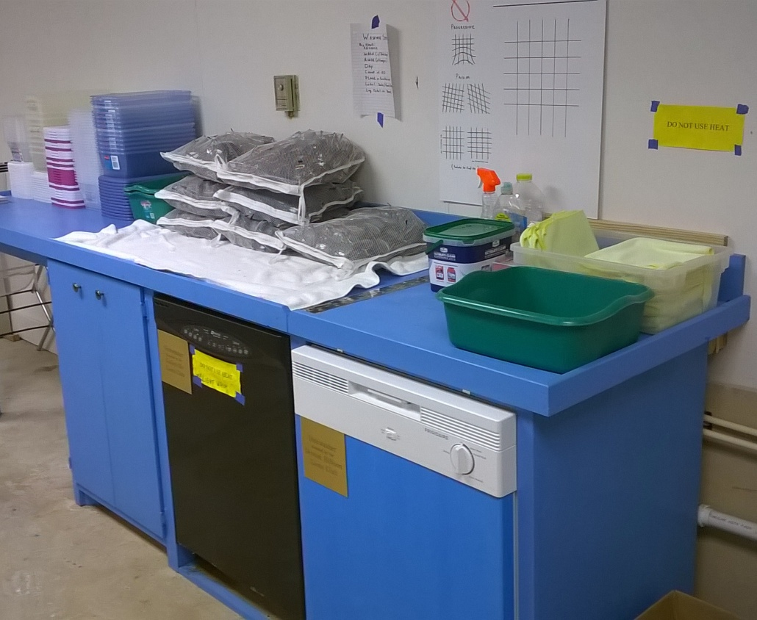
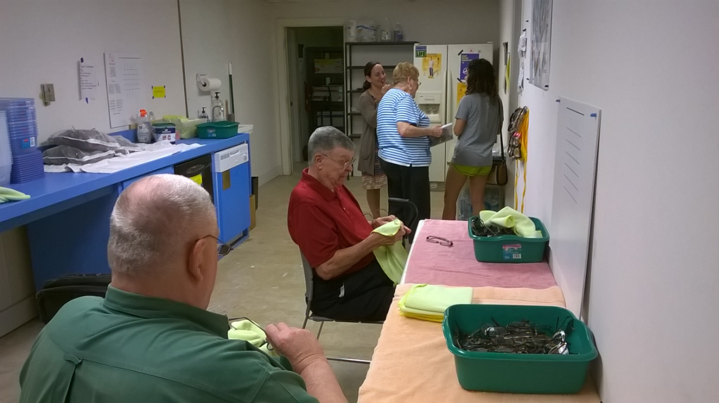
Glasses are washed in one of our 2 dishwashers or washed by hand.
Processing Glasses Step 2: Washing & Drying
All glasses are dried by hand and once again inspected for defects.

Slide 10
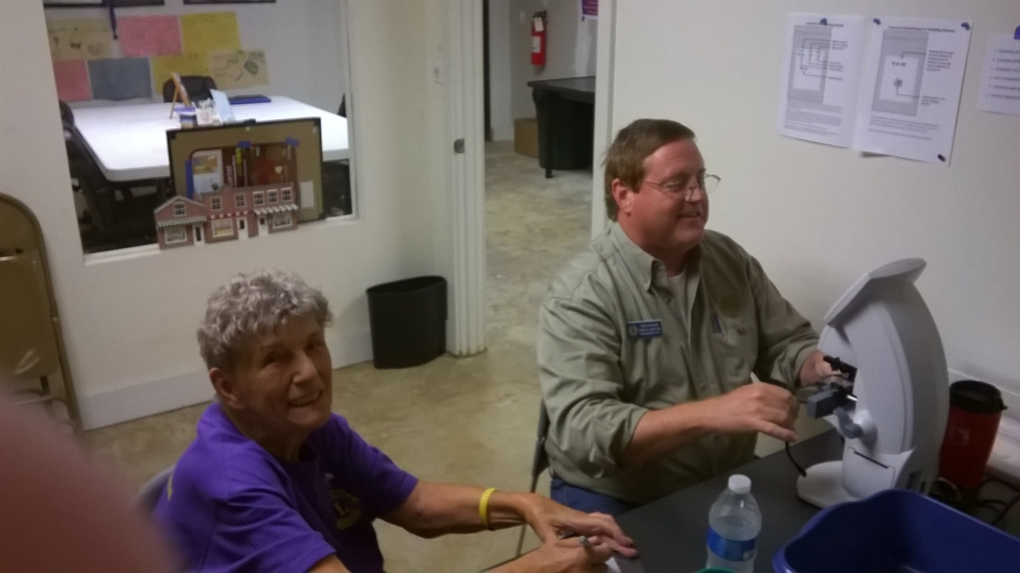
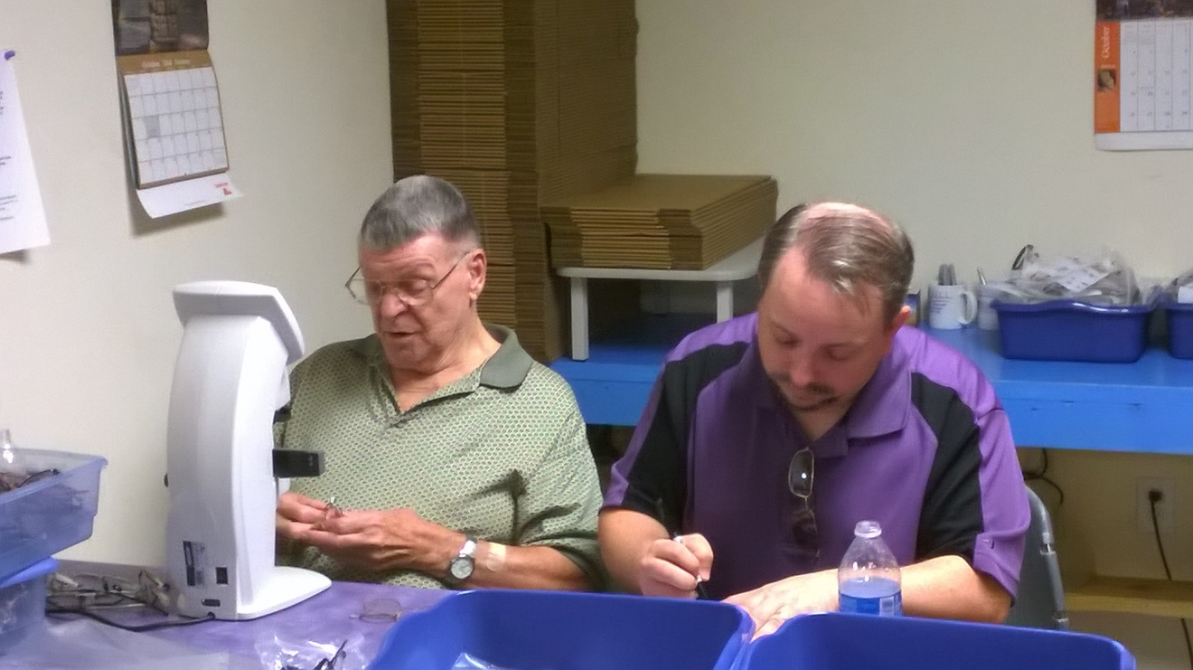
Glasses that pass inspection are placed on one of our 4 lensometers to read the prescription (sphere, cylinder, axis and pupillary distance).
Processing Glasses Step 3:
Reading the Prescription
Glasses are then placed in a plastic bag and put into a box that contains 50 pairs of glasses. These boxes are now ready to send on a mission.

Slide 11
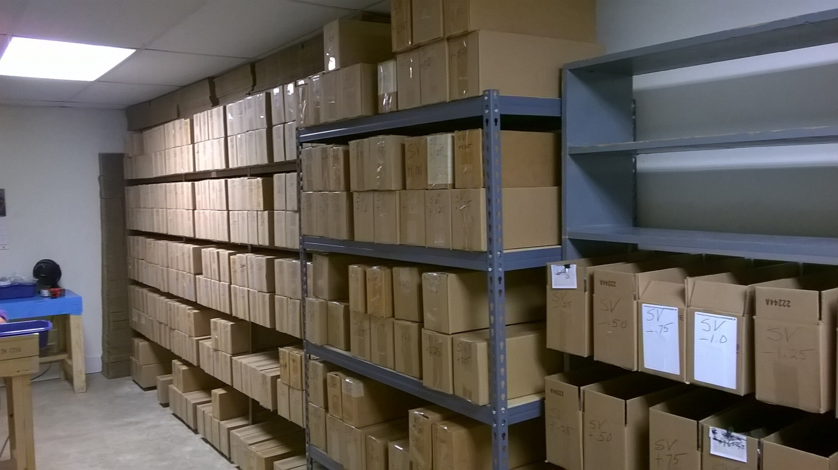
In the 2014 — 2015 Lions year, the District 2E2 Eyeglass Recycling Center provided 12 missions with 18,000 pairs of glasses. Another 14,000 were sent to the Texas Lions Eyeglass Recycling Center in Midland for missions supplied from there.
Glasses Ready to Go Around the World

Slide 13
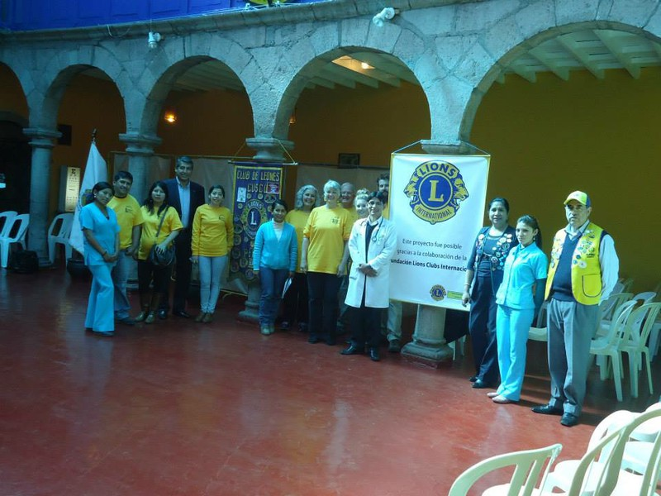
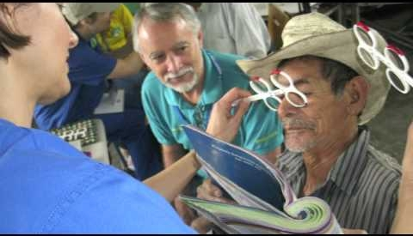
Glasses are available for
Church and Medical missions
The District 2E2 Eyeglass Recycling Center will provide eyeglasses, when available and without cost, to those missions who have a method of determining the refractive status of the eye.

Slide 14
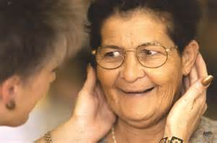
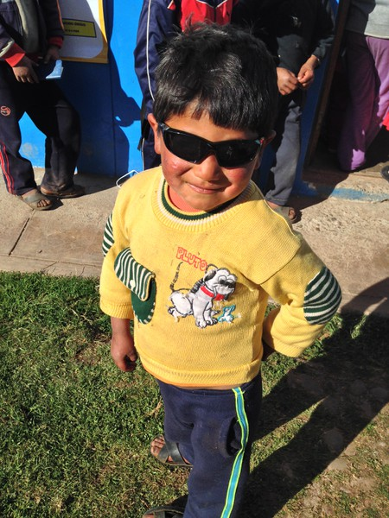
Donate glasses and change someone's life. Imagine if you could: w help a child read w help an adult succeed in his job w help a senior maintain her independence w provide a community with more opportunities to grow and thrive Everyday, our recycled eyeglass programs do all of this and more.
Free to You – Priceless to Them

Slide 15
We Need YOU
The District 2E2 Eyeglass Recycling Center needs all the glasses your club has collected. More importantly, we need your help to process these glasses to have them available for missions that will put them on a person in need. Please make plans for your club to visit YOUR eyeglass recycling center for a work day. No matter your age or physical abilities. Everyone Can Be Productive.
Texas Lions Eyeglass Recycling Center
Midland, Texas

